Slide 1
The role of buildings in Climate Change Adaptation
Buildings in the geospatial domain
Danny Vandenbroucke
KU Leuven (SADL)

Slide 2
Learning Objectives
To identify different types of buildings and explain their variability
To understand and discuss how buildings can be represented in a geospatial context
To recognize and explain the most important EU initiatives related to buildings
To understand and discuss the potential role of buildings in the context of climate change challenges

Slide 3
Structure of the lecture
Buildings and the urban fabric
Modelling buildings as geospatial objects
Buildings in important European initiatives
The role of buildings in CCA & CCM
Conclusions

Slide 4
Structure of the lecture
Buildings and the urban fabric
Modelling buildings as geospatial objects
Buildings in important European initiatives
The role of buildings in CCA & CCM
Conclusions

Slide 5
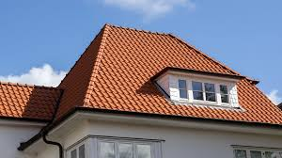

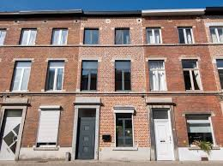
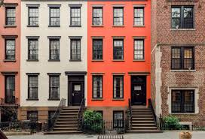

Buildings are everywhere …
Roof
… consist of different parts
Interior
Facade
Roof

Slide 6
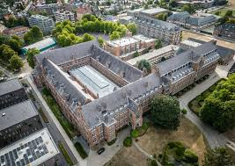
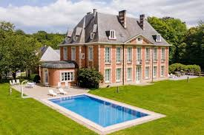
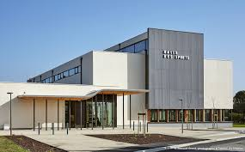
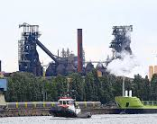
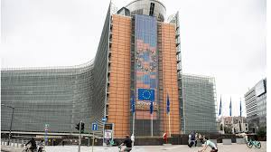
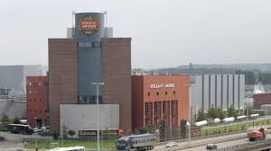
They are of different types …
School
House
… related to different functions
Sports hall
Office
Factory
Factory

Slide 7
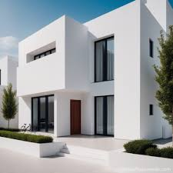
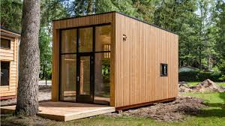
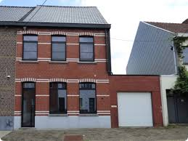

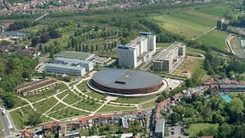
They are of different size …
Modern house
Tiny house
… and form
Old house
Special shapes
Skyscrapers

Slide 8
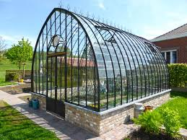
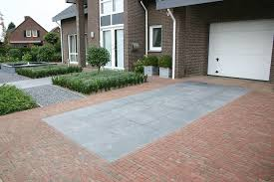
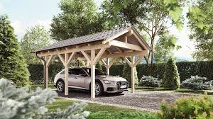
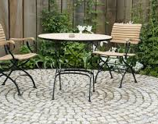
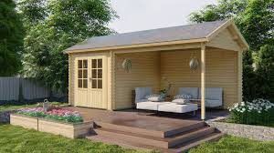

Houses are not isolated …
Parking space
… they have connected parts
Green house
Car port
Tuinhuis
Terras
Garden

Slide 9
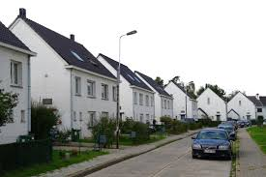
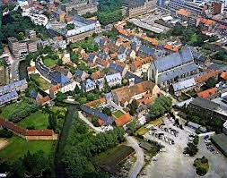
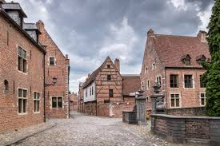
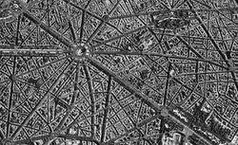
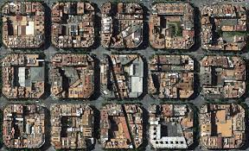
They are interconnected …
… the urban fabric
Beguinage
Social housing
Beguinage (Leuven)
Paris urban fabric
Buildings as part of neighbourhoods and districts
UK

Slide 10
Structure of the lecture
Buildings and the urban fabric
Modelling buildings as geospatial objects
Buildings in important European initiatives
The role of buildings in CCA & CCM
Conclusions

Slide 11

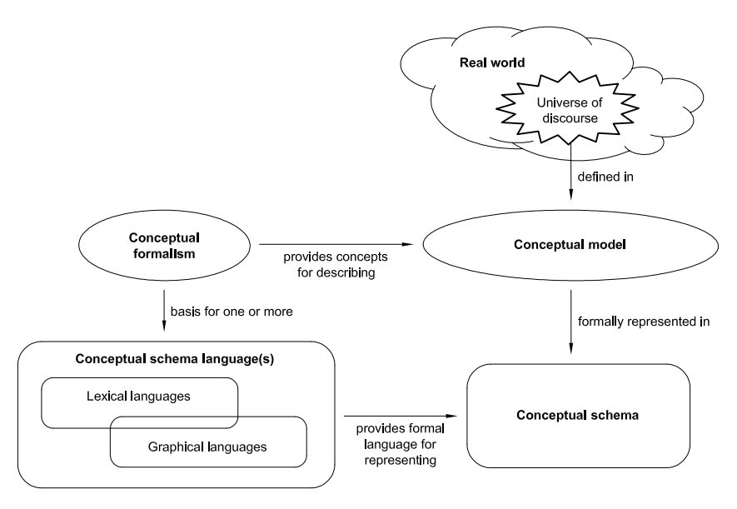
Linking real world with digital world
… creating geospatial data models
ISO/TC 211
Geomatics
ISO 19100
Family of standards

Slide 12
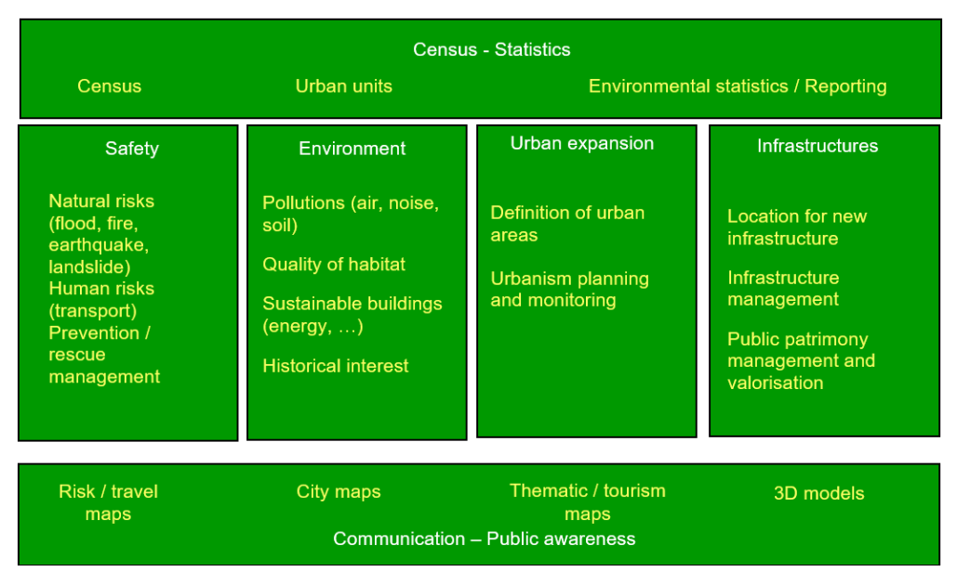
INSPIRE data specifications
… for 34 themes (including buildings)
The high level use cases for buildings

Slide 13
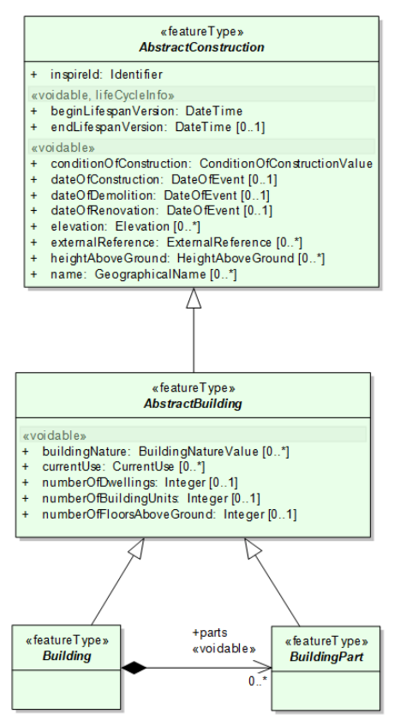
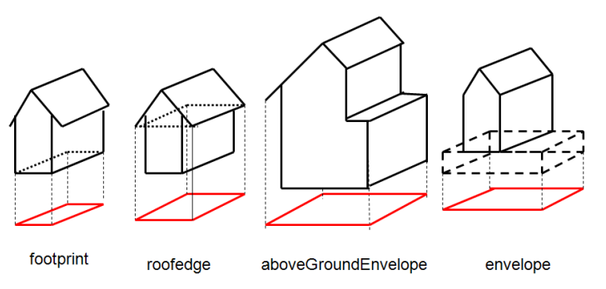
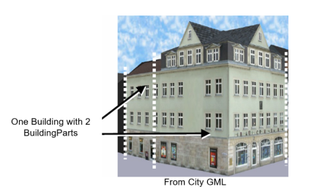
INSPIRE data specifications
… detailed model
Including geospatial features, attributes
Horizontal
Geometry
Reference

Slide 14
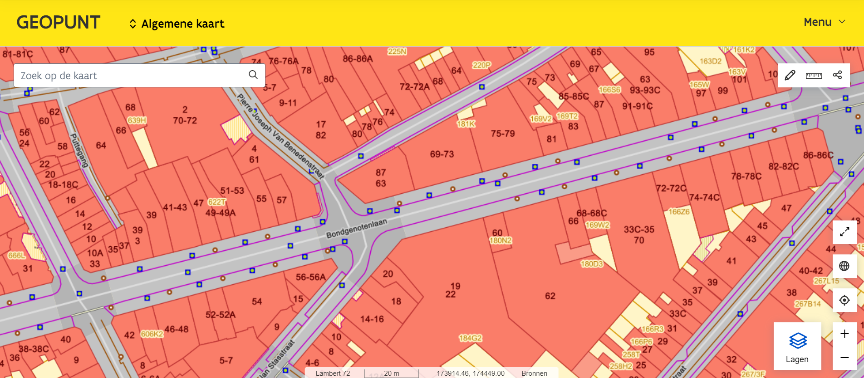
From 2D to 3D …
Large-scale Basmap Flanders
… Using footprints

Slide 15
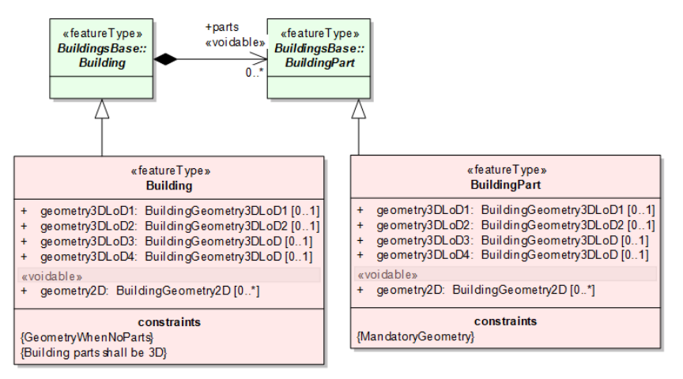
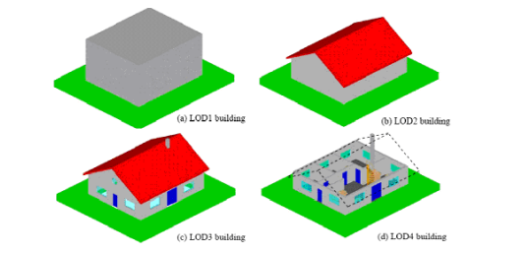
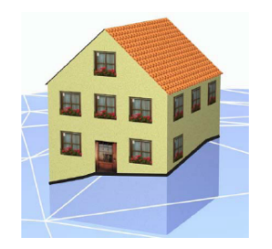
From 2D to 3D …
… also in INSPIRE
Terrain intersection
(black line)
Using CityGML standard
(Open Geospatial Consortium)

Slide 16
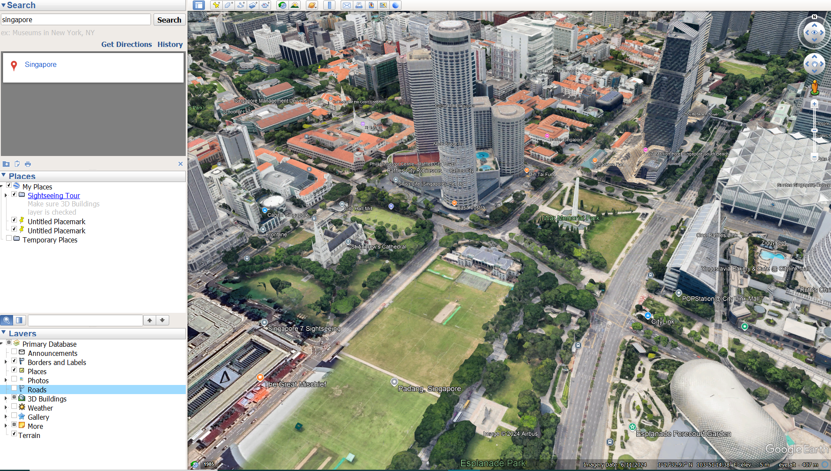
Keyhole Markup
Language …

Slide 17
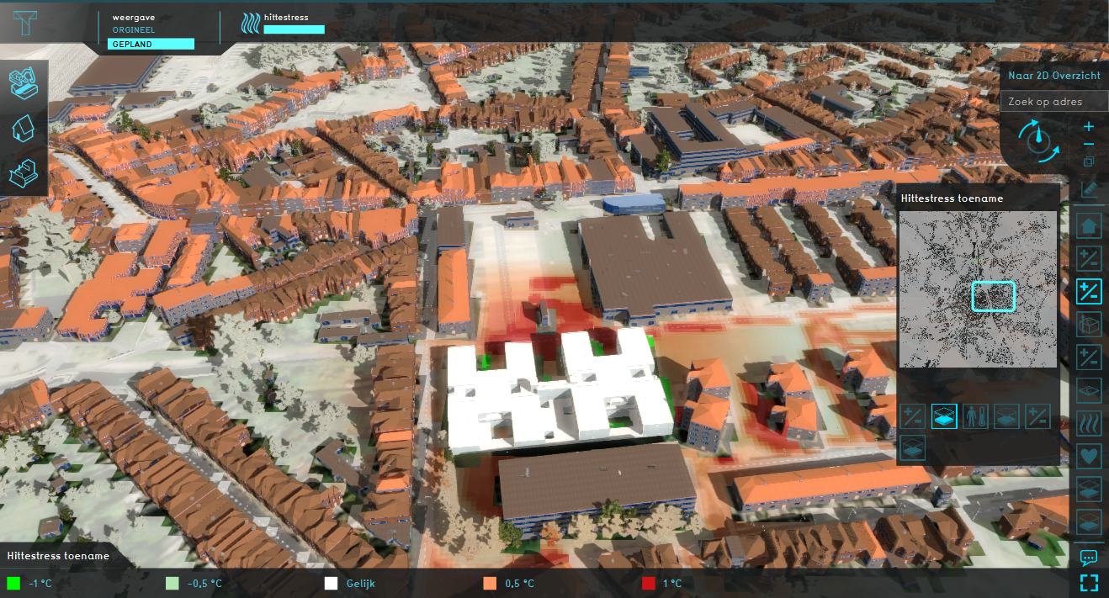
From 2D to 3D …
Example: Belmap- and Tygron platform
Simulating the impact on heat stress when implementing a new building (BIM)
… Towards Digital Twins

Slide 18
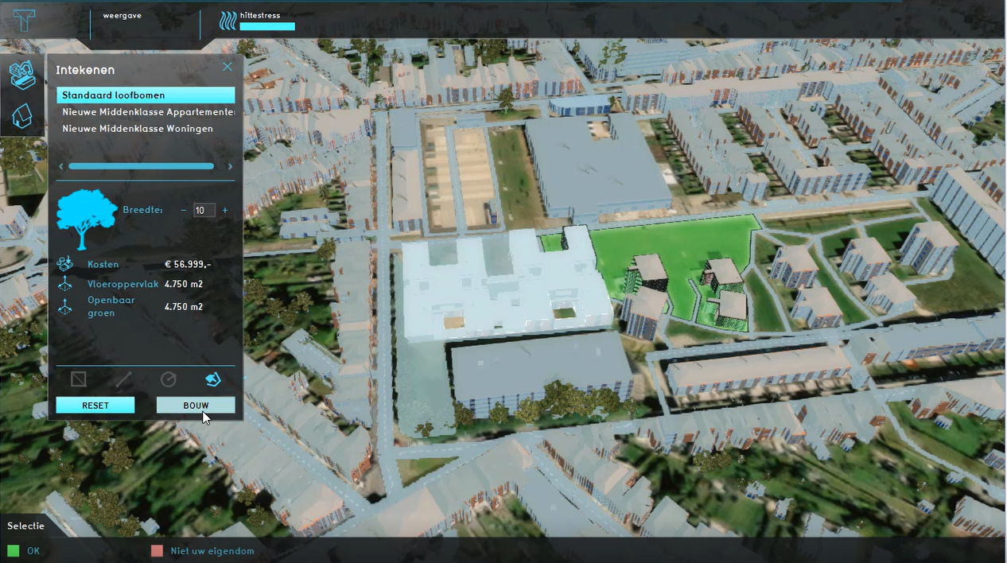
The impact of compensatory measures can be explored - e.g. planting trees

Slide 19
Implementing new technologies …
… Combining CAD, GIS, Remote Sensing (RS)
The architectural world is used to CAD-tools, BIM as well.
This can be combined with geospatial and RS technologies …

Slide 20
Structure of the lecture
Buildings and the urban fabric
Modelling buildings as geospatial objects
Buildings in important European initiatives
The role of buildings in CCA & CCM
Conclusions

Slide 21
Buildings in European initiatives
… of course there are more
The already mentioned INSPIRE Directive was already mentioned
Focuses on geospatial data sharing and interoperability
The Convenant of Majors
Focuses on energy and climate actions at local level
The New Europena Bauhaus (NEB) initiative
Focuses on transforming the built environment and lifestyles (citizens)
Built4People (B4P) projects and network
Focusus on projects related to climate, energy and mobility

Slide 22
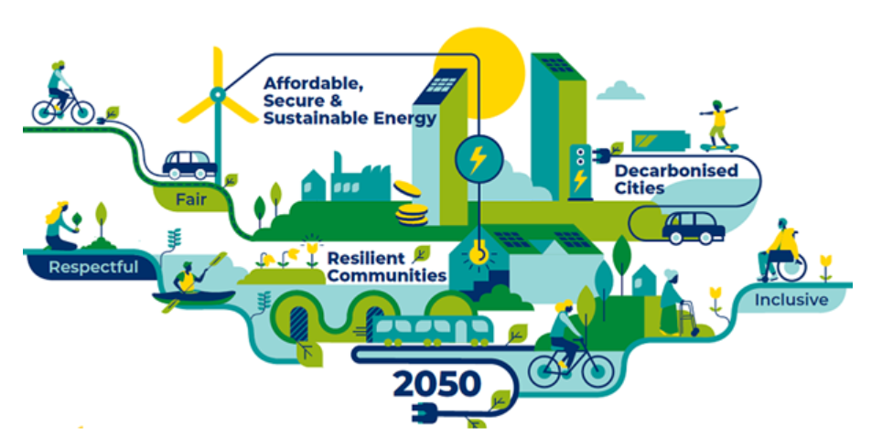
Convenant of Majors
… plans, actions and community building
Reducing GHG emissions by 55% by 2030
Strengthening resilience
Alleviating energy poverty
Examples:
Cities Heat Detox
Cities Energy Savings Sprint

Slide 23

Convenant of Majors
City Heat Detox
… plans, actions and community building

Slide 24
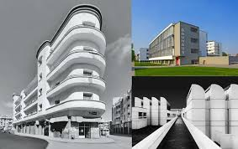

New European Bauhaus
… Is also an architectural style / mouvement
sustainability, from climate goals to circularity, zero pollution, and biodiversity
aesthetics, quality of experience and style beyond functionality
inclusion, from valuing diversity to securing accessibility and affordability

Slide 25
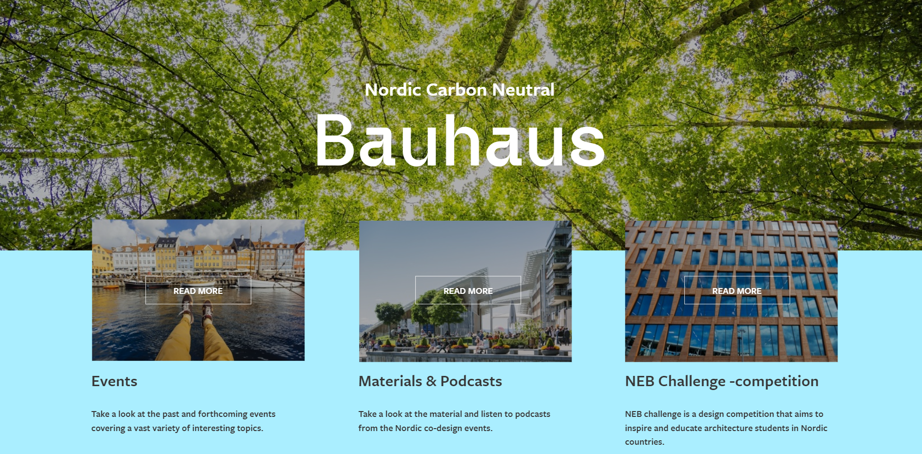
NEB Labs

Slide 26
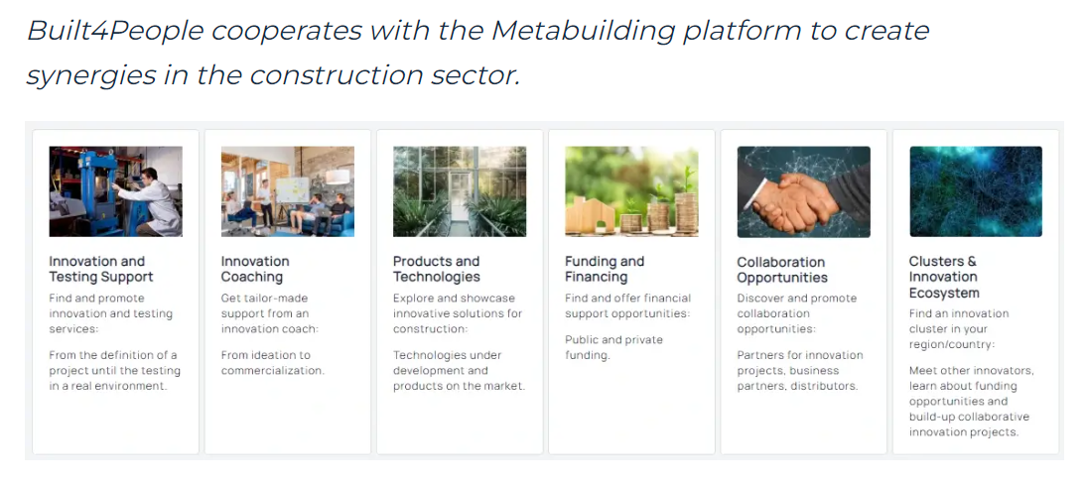
Built4People
… Part of Horizon Europe’s Cluster 5 (Climate, Energy and Mobility)

Slide 27
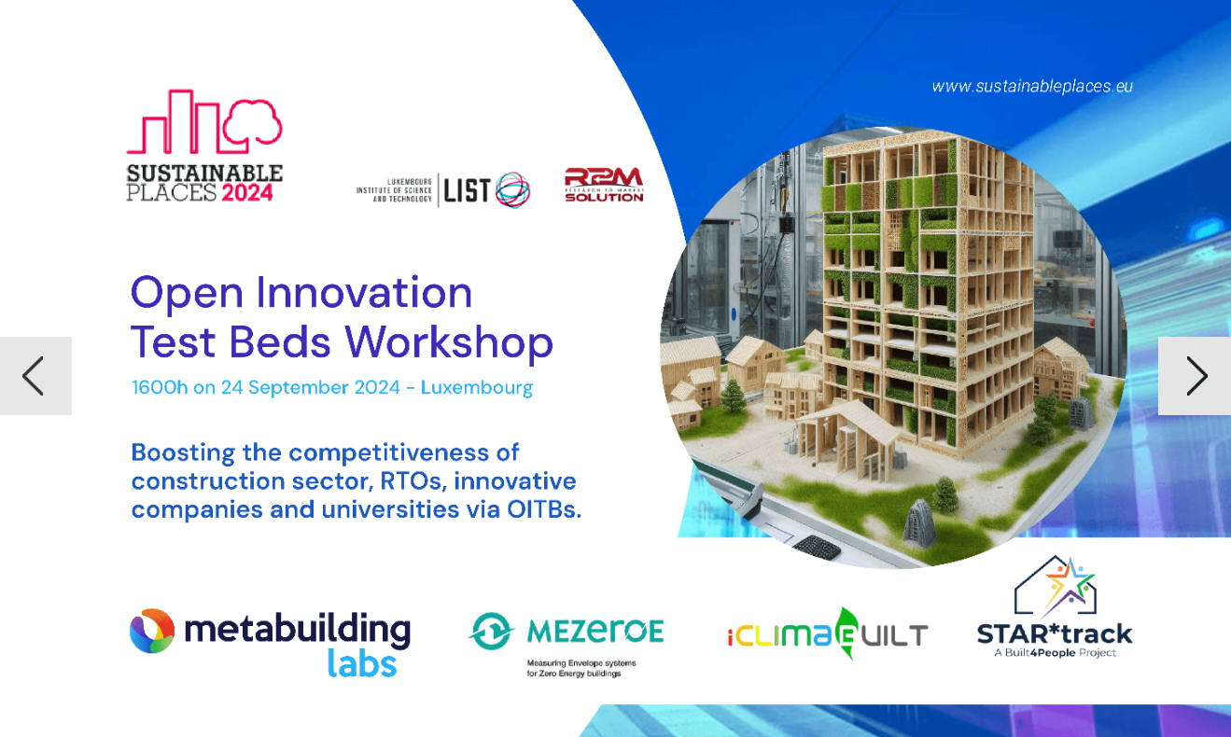
Built4People
The METABUILDING platform is the digital meeting place for the innovation ecosystem of the European built environment sector.​​ It brings together stakeholders from the construction sector and emerging industrial sectors such as recycling & circular economy, additive manufacturing, nature-based solutions, and the digital industry.

Slide 28
Structure of the lecture
Buildings and the urban fabric
Modelling buildings as geospatial objects
Buildings in important European initiatives
The role of buildings in CCA & CCM
Conclusions

Slide 29
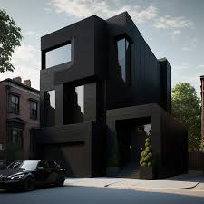
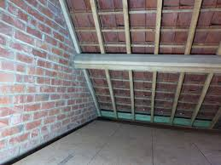
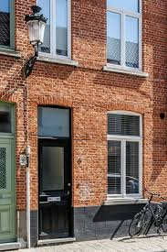
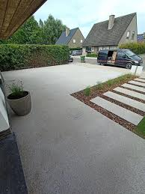
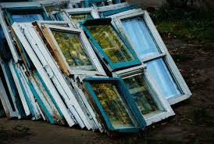
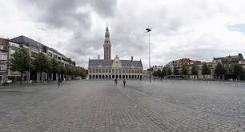
Role of buildings in CCA & CCM
Dark colours
… they can negatively or positively impact CC
Non-isolated roofs
In Belgium, 22% of CO2 is emitted by houses, 8% by other buildings
Old walls
Paved squares
Paved gardens
Old windows

Slide 30
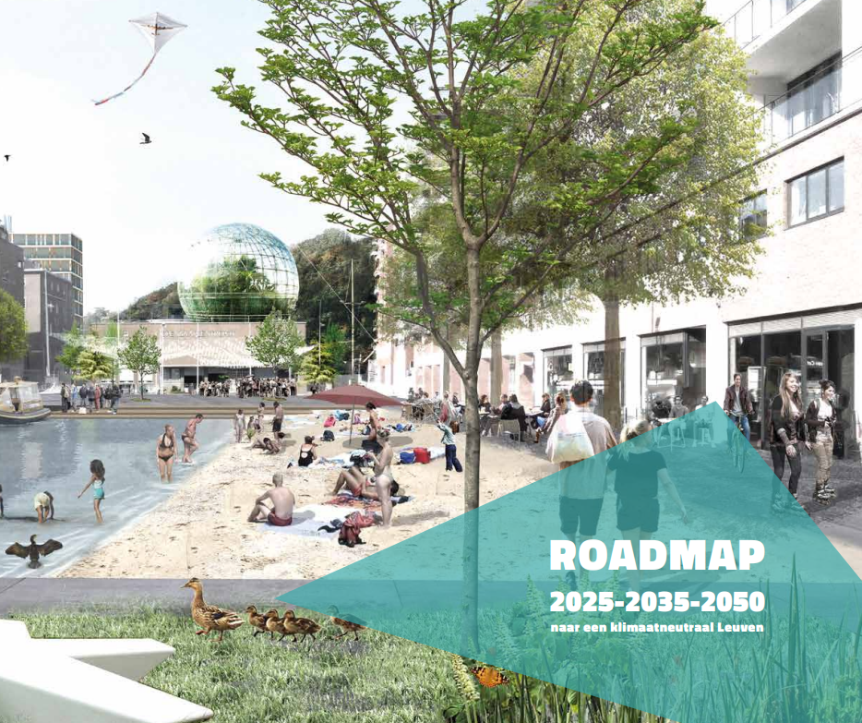
Role of buildings in CCA & CCM
… Example of Leuven 2030
Key Programmes
Renovate residential buildings
Renovate other buildings
Climate-neutral new buildings
A vibrant core and smart locations
Sustainable model shift
Greening vehicles
Green energy
Sustainable & healthy food
Greening (public) spaces
…

Slide 31
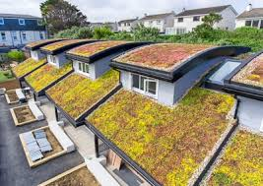

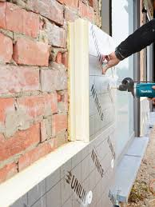
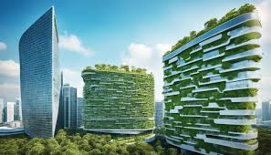


Role of buildings in CCA & CCM
Green roofs
… Citizens can contribute, cities act & incentivize
Light colours
Leuven
Green Roof: 500-7000€
Planting tree: 75€
Rain Garden: 350€
Water pit: 500€
Green buildings
Isolating
Unsealing soils
Rain Garden

Slide 32



Role of buildings in CCA & CCM
Greening of public space …
Nature-based
Solutions

Slide 33

Current situation

Slide 34

Small

Slide 35

Medium

Slide 36

Large

Slide 37


Role of buildings in CCA & CCM
Supporting different ecosystem services
Water retention
Biodiversity
Pollination
Air quality
Cooling
CO2 storage
Food production
…
Tile Rockers in Flanders:
5.302.065 tiles broken

Slide 38


Role of buildings in CCA & CCM
Gardens can play a major role
Citizens Science

Slide 39
Structure of the lecture
Buildings and the urban fabric
Modelling buildings as geospatial objects
Buildings in important European initiatives
The role of buildings in CCA & CCM
Conclusions

Slide 40
Some conclusions
Buildings are a key part of our built-up area, especially in an urban context
They are modelled and a key part of any Spatial Data Infrastructure (2D to 3D)
Several European initiatives support energy and CCA/CCM interventions, with a dedicated role for buildings
Buildings might contribute to CC, but also to its solutions

